Slide 1


ODYSSEY 2

Slide 2

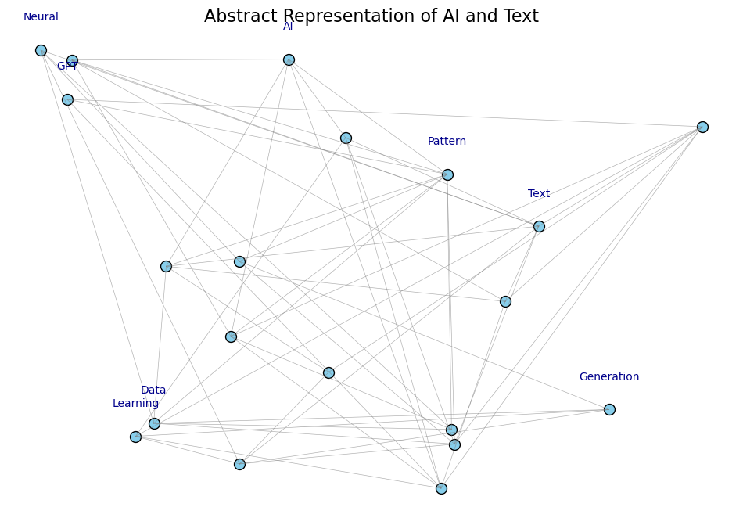
Generative Text Model
Welcome to Data Odyssey 2 : The Quest for Language Mastery! In this presentation, I’ll take you through an exciting journey of text analysis, NLP techniques, and generative modeling. Lets Explore how these powerful methods help uncover hidden patterns in language and generate new content based on learned patterns.

Slide 3
Introduction to the project
The goal of this assignment was to explore a text dataset, build NLP pipelines, and generate new content using AI. The quest consists of four level :
Lv. 1
Exploreing the dataset and understanding the text structure.
Lv. 2
Building NLP pipelines to preprocess and extract meaning from the text
Lv. 3
Creating new content with a generative model
Lv. 4
Presenting the model’s outputs and insights in a meaningful way.

Slide 4
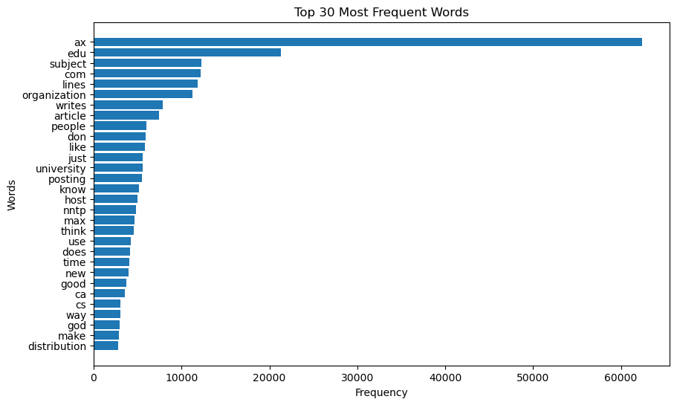
Level 1 – Understanding the Terrain (EDA)
In this first stage of our journey, we’re exploreing the dataset. The goal here is to familiarize ourselves with the structure of the data, look at the word distributions and detect any interesting patterns. We’ll begin by analyzing the number of documents in each category and some basic statistics on word frequency.
Insight :
This chart suggests a diverse range of topics, from academic and technical discussions to personal narratives and general conversations. The prominence of ‘ax’ is intriguing and warrants further investigation to understand its significance within the dataset

Slide 5
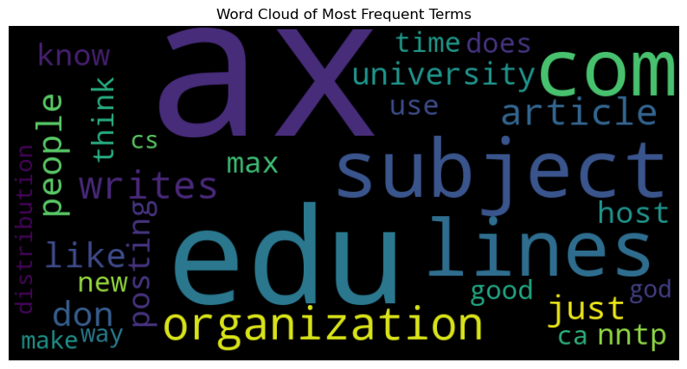
EDA – Word cloud of Most Frequent Terms
For this slide, we will visualize the most frequent terms in the dataset using a word cloud. A word cloud provides an intuitive and visually appealing way to observe the relative importance of different words. The more frequently a word appears in the dataset, the larger and bolder I will appear in the word cloud. This helps us quickly spot dominant themes or keywords that may be central to the text data
‘ax’ is the most frequent word, appearing in large font size. However, without additional context, it’s difficult to determine its specific meaning within the dataset.
‘university’, ‘edu’, ‘subject’ suggests that the dataset may contain academic or educational content, possibly related to university discussions or research papers
‘com’, ‘article’, ‘writes’ indicates a focus on written content, such as article, posts, or essays
‘lines’, ‘host’ might suggests technical discussions or conversations about online platforms
‘people’, ‘think’, ‘like’, ‘new’ suggests a focus on human perspectives, opinions, and current events
The word cloud suggest a diverse range of topics within the dataset, potentially covering academic discussions, online forums, and general conversations. The prominence of “ax” is intriguing and warrants further investigation to understand its significance within the dataset

Slide 6
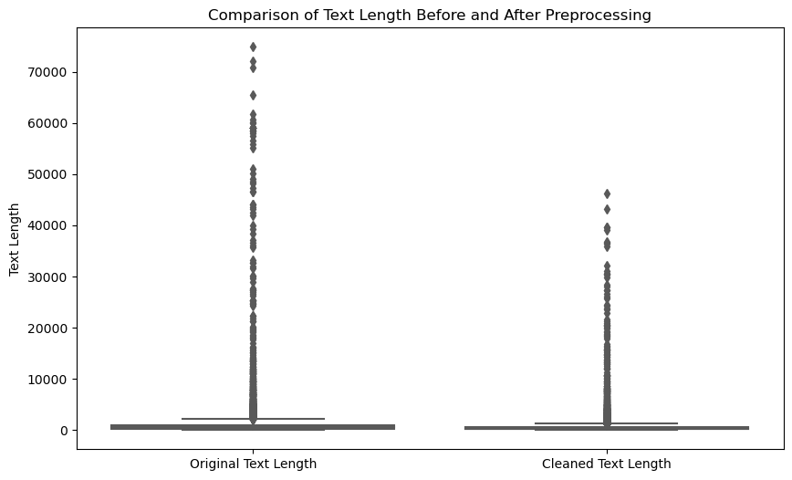
Level 2 : Power-ups & secret moves (preprocessing)
In this step, I’m using “Power-Ups” to clean and process the text data. This ensures I’m working with useful information and avoid noise. Here’s what I’m doing :
I remove specific words and repetitive bigrams that don’t contribute to understanding the text
I eliminate non-alphabetic characters and unnecessary symbols to focus only on words
I break the text into individual words (tokens) for easier analysis
Words are reduced to their root forms, so we treat similar words as one.
We remove common, non-essential words, which help focus on the meaningful words in the text
These steps clean the data, making it easier to analyze. By focusing on relevant words and removing the noise, we ensure that our model works with the most important information. Setting us up for better text classification or topic modelling results

Slide 7
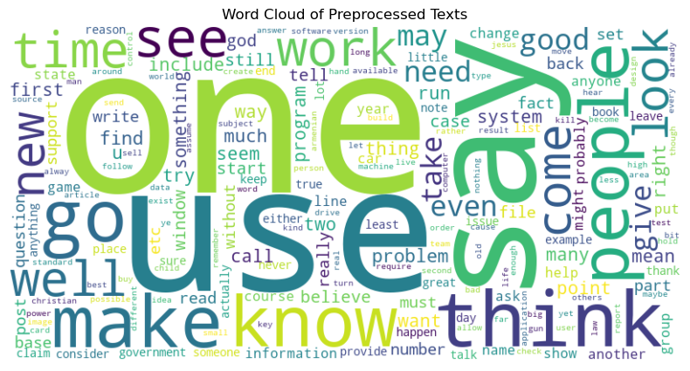
Level 2 : Feature Extraction and Transformation
We’ve successfully cleaned our text data in the previous step. Now, we will extract key features to represent our text in a format suitable for machine learning models. The following steps are critical in transforming our text into numerical data :
In this step, we transform our text into a suitable format using :
CountVectorizer to converts the text into numbers by counting how often each word appears. We identified the most frequent words in the dataset.
I’m capturing common word pairs (bigrams) using Bigram Vectorizer. This helps us spot frequently occuring word combinations.
TF-IDF to highlights important words that are both frequent in specific documents and rare across the dataset, showing what makes each document unique.
Word Cloud to visualize the most frequent words in the dataset.
This Word Cloud visualization of processed text shows the significant differences before and after we’ve done preprocessing than the one shown on previous slide.

Slide 8
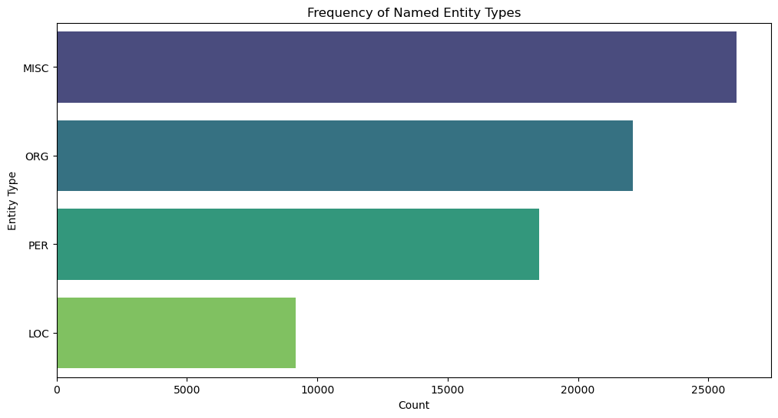
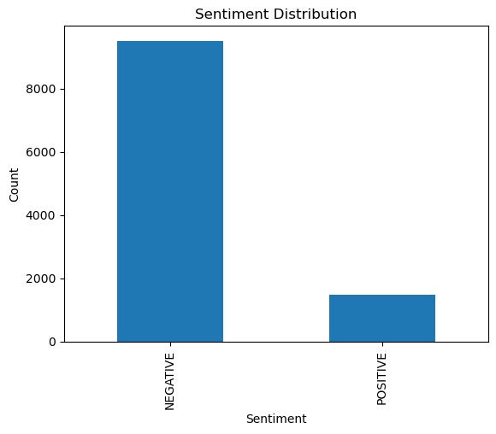
Level 2 : NER & Sentiment Analysis
Now we’re going to extract key entities from text using Named Entity Recognition (NER) and analyzed the overal tone using Sentiment Analysis. These steps help us understand the important entities mentioned in the text and the general sentiment of the content
We used a BERT model to identify entities such as people, organizations, and location in the text
We applied a sentiment model to categorize the text as positive, or negative

Slide 9
Level 3 : Creating Fresh Content with GPT-2
In this stage, we unlock the generative vault by using GPT-2, a powerful language model. With GPT-2, we can generate new text based on patterns it learns from existing data. By giving it prompts like “hockey game” or “latest trends in artificial intelligence”, we can create relevant and creative text, just like a journalist or storyteller.
Insight :
Pattern Learning : GPT-2 learns from the data to generate text that feels natural and relevant
Customizable Output : You can control the output by adjusting settings like temperature (for creativity) and top-k/top-p (for diversity)
Creative or Reliable : You can choose between creative text (for storytelling) or reliable text (for factual content)
“Hockey Game:” | “Latest trends in artificial intelligence”
The NHL is a great place to watch hockey. It's a place where you can watch the game, watch your favorite players, and watch a lot of other sports. The game is great for kids, but it's also great to have a family. There are a few things you need to know about hockey, including: ... (1) The league is not a "team sport." , the league isn | The number of people who are using artificial intelligences to solve problems has increased by more than 50% since the beginning of the year, according to a new report from the University of California, Berkeley. ... (The U.S. Department of Homeland Security has estimated that the number who use artificial intelligent systems to help solve crimes has risen by nearly 50 percent since 2014, and that this number is expected to continue to increase.) , the U, has projected that artificial Intelligence will be used in the next five years to improve the quality of life of Americans. The report also predicts that by 2020, artificial AI will become the dominant technology in our lives. (See also: Artificial Intelligence:

Slide 10
Key Takeaways
As I reflect on this project, I’m proud of how it has achieved its primary objective, exploring the capabilities of generative AI for creating context-specific text. The AI was able to generate creative and relevant outputs, demonstrating its potential for applications like content creation, customer engagement, and educational use. However, I also encountered limitations, particularly overlapping or repetitive outputs, which highlighted the importance of fine-tuning and post-processing.
This project has shown me that generative AI is a powerful tool, but it’s not a one-size-fits-all solution, it requires thoughtful customization and validation to ensure quality results
Looking ahead, I see exciting opportunities to build on this work. I plan to explore more advanced models, such as GPT-4, which could provide even better contedxt understanding the coherence. Refining preprocessing methods to handle overlapping or irrelevant text is another step I’d like to take to improve the outputs further.
To me, the potential for generative AI is immense, transforming how we create, communicate, and solve problems. This technology is more than just a tool; it’s a whole new way to think about content creation and interaction.
Thank you for your attention, and I’d be happy to answer any questions or hear your thoughts!

